Slide 1
React Testing
Joel Thornton
October 8, 2019
Notes:
Hi I’m Joel. Were going to be talking about Unit Testing in React.
Option #2
First I want you to consider the Ibex.

Slide 2

Is Testing an Obstacle or Opportunity ?
https://www.youtube.com/watch?v=mnMJpCL79S0
Notes:
I love this video of the Ibex scaling this vertical dam in Italy.
He’s after the salts that are dissolved into the little drip of water right at the top of the Dam.
His bones and nervous system needs the dissolved minerals. He needs them so much that he’ll climbs hundreds of feet high up a vertical wall to get it.
When the lower portions of the rock wall have already been exhausted he climbs almost to the rim of the dam wall to get it.
Are tests an obstacle for you ? Something you have to scale in order to get the promised benefits.
I want us all to be like the Ibex when it comes to testing. No fear, just careful deliberate action toward the top where the best testing can be done.

Slide 3
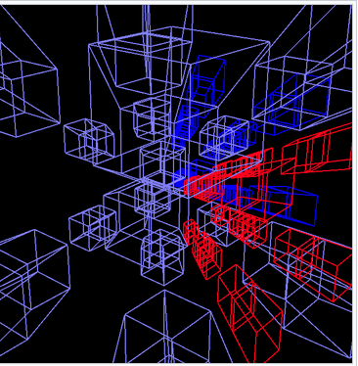
Accept The Testing Challenge
Component Lifecycle
Async Events and Changing DOM
Module Hierarchy
Rendering and Code Re-entry
State (Hooks, Reducers, Events)
Routing
External Interfaces and Libraries
Business Logic
Error Handling
Notes:
Our wall of testing is the many dimensions of complexity that react throws at us.
Here are a few of them.
These challenges can be daunting if you focus on them too much.
You might even decide that you might as well not do any testing. Or perhaps just do manual testing.
Maybe nothing has happened so far and you think it’s ok to just keep going.
We’ll I’m here to encourage you to keep a good attitude because you really do need them.
It not as hard as you are imagining.
There will come a point when they might just save you.

Slide 4
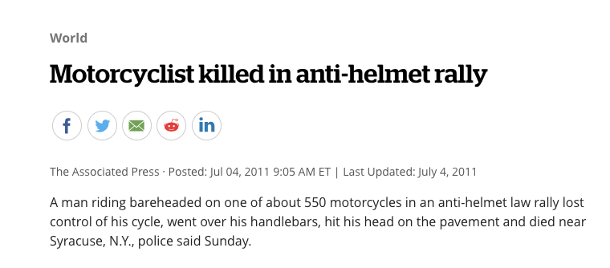
Keep a Good Attitude
Notes:
Keep a Good attitude. Testing can be your friend.
They give confidence you need to know that your code is working at you intended it to for you patrons.
If you start saying something like, I don't need tests, or tests take too much time to write. Your setting yourself up for humbling experience.

Slide 5
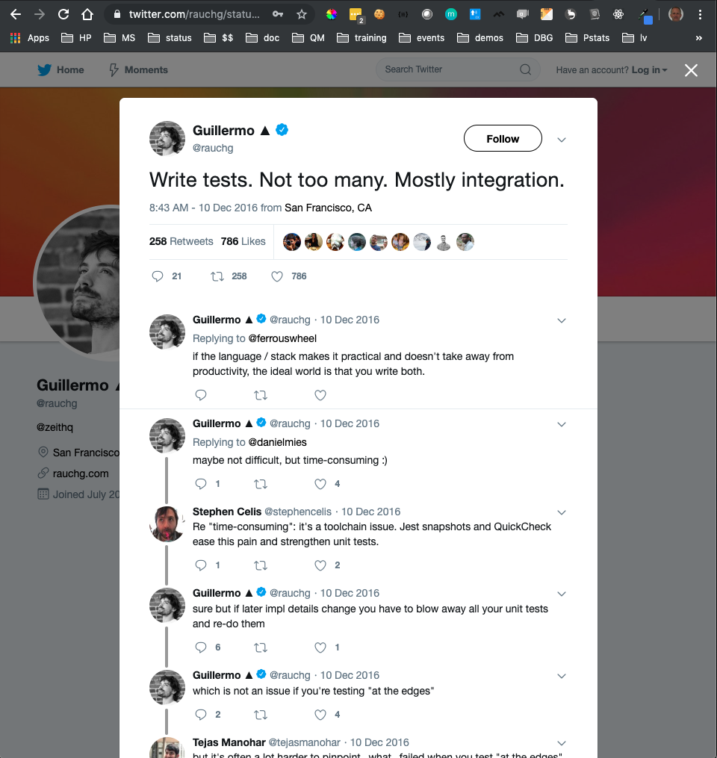
Promote a Positive Testing Culture
Keep Tests Easy
Avoid False Alarms
Write No More Than Necessary
Ensure Tests are Helpful in Finding and Preventing Real Bugs
Notes:
I think it’s critical that you promote and protect your team’s and organization’s attitude towards testing.
Tests should be :
Easy to Develop and Maintain
Avoid False Alarms
No more than Necessary
Helpful in Finding and Preventing Real Bugs that affect your patrons
This famous tweet by Guillermo Rauch‏ did a lot to promote keep writing tests in a helpful and responsible way.
Why mostly integration tests ?

Slide 6

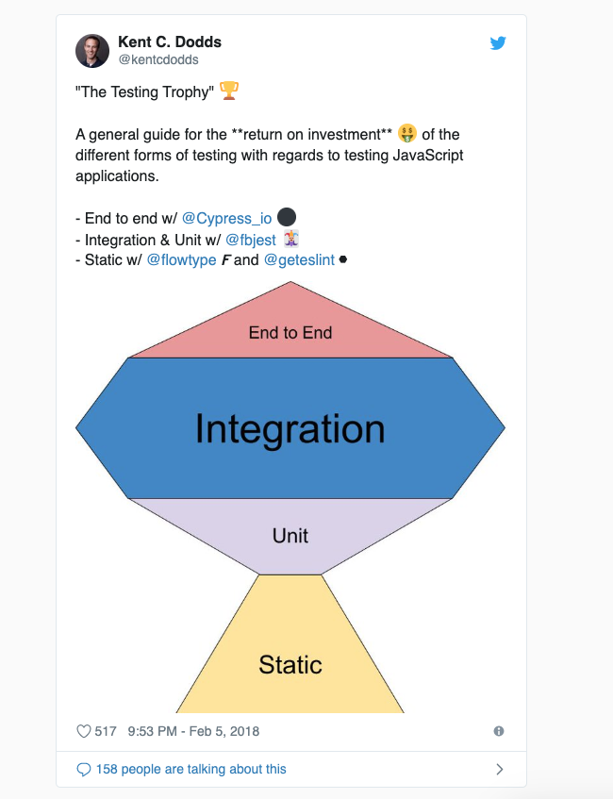
Trend Upward
E2E Best but $$$
Integration Tests Better Than Unit and Cost about the Same
Use More Static Analysis
ESLint, Prettier, Typescript, Flow
Notes:
Most now believe that tests improve as you go up the hierarchy.
In other words. E2E tests are the best but they are also the most costly.
Traditionally integration tests have also been more costly than unit tests.
However changes in tools have brought integration test costs more in line with unit tests costs.
Since integration tests often overlap the tests of subcomponents, we can eliminate many of the unit tests.
In many cases unit tests are no longer necessary. The line between integration and unit tests has blurred.
At the same time static typing and linting tools like ESLint, Prettier, Typescript, Flow help us eliminate the need for a whole range of testing.
Kent Dodds describes the new form as a trophy. It not only proportions the number of tests differently it also eliminates many of them.

Slide 7
Simplify and Reduce
To innovate does not necessarily mean to expand; very often it means to simplify.”
Elder Russell M. Ballard
Remove tests that:
Test paths that a normal user could not trigger
Are duplicated by higher level tests
Are validating implementation details
Test framework or external components
Fail intermittently
Notes:
The best tests are tests that we don’t have to write.
These are some of the tests that you should delete.
Feel free to rewrite some of tests that fail intermittently but do that on your own time.
Don’t block others from getting their work done. Or promote a negative Testing Culture.

Slide 8
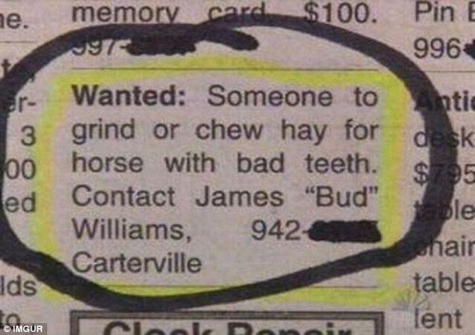
Most people would rather chew hay for a horse with bad teeth than fix your broken tests !
https://boredomtherapy.com/worst-jobs/

Slide 9
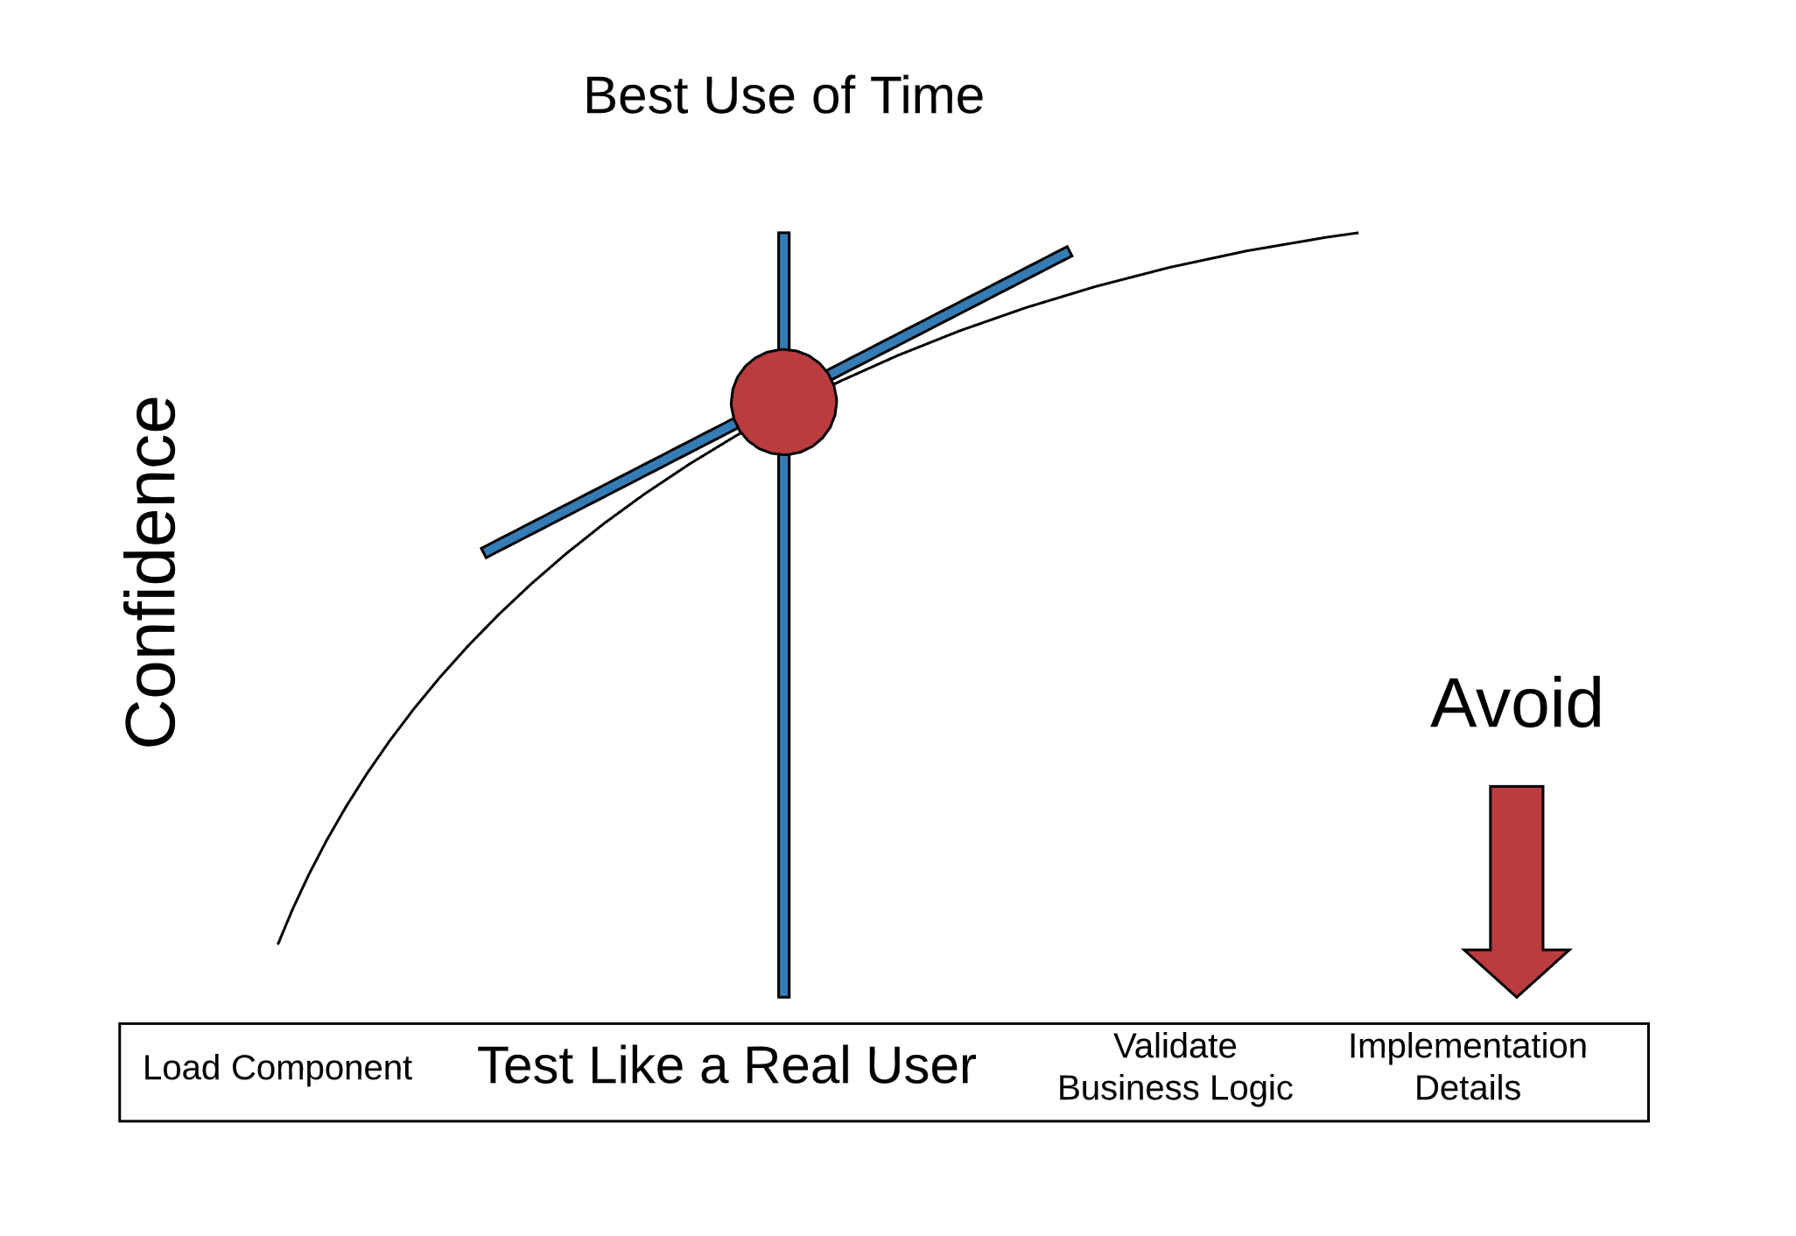
Determine How Much Time You’ll Spend
Coverage
Aaron Abramov – Establishing Testing Patterns With Software Design Principles
Notes:
You need to balance the confidence your product requires with the cost of carrying test code debt.
At a minimum you should have at least one test that loads your component and verifies that it doesn’t crash.
You’ve gone too far if you’ve started testing implementation details that the patron doesn’t care about.
Or if your tests are triggering paths that the patron could not possibly get into, or if you are using DOM querySelectors that will break on refactor.
There is a lot of room in-between
Meet as a team to decide how and where you think the best use of your time is.
Remembering that all tests are not equal and they do cost time and money. When your writing and maintaining tests your not writing and delivering new features.

Slide 10
Filter Bugs Throughout
Basics
$
Static
Static
Analysis
Unit
Inte
gration
$$$
Automated UI
Prod Monitoring and Testing
Notes:
In figuring out costs it’s good to look at the overall test process you have.
You can think of each test stage as a filter.
You would like to filter out bugs early in the process. Because the longer they stay in your code the more expensive they become.
You would like your static analysis to filter out the biggest chunk of bugs.
Next you would like your unit, and integration tests to catch them.
The next bunch of bugs you would like to catch are automated UI.
your CI – travis tests to catch a bunch.
your pipeline integration tests to catch before going to production.
Once you get to prod you want very few bugs that you monitoring and testing can help you root out and maintain.

Slide 11
Learn the Fundamentals
Basics
Design Patterns
Process Integration
https://github.com/thorntonjn/sort-2019-react-testing
Notes:
Joel – Ok, let’s go through the testing in react.
Installation, tools, where files live, basic test structure. Then let’s consider some common challenges that most people run into and some design patterns for overcoming them.
We’ll finish up with how to integrate your tests into your CI pipeline work.
Testing locally before you commit and testing in Travis to gate PRs.
My hope is that we can share experience and information that will actually save development time and improve the quality of our code.
I’ve created a github repo at https://github.com/thorntonjn/sort-2019-react-testing
I hope that it will be helpful, I’m not a good demoer and I personally think it will be more valuable for you to focus on the slides and the concepts I’m presenting then watching me code.

Slide 12
Use Static Analysis Tools
Basics
Es-lint
Create Linting Rules
Prettier
Configure to use es-lint rules
TypeScript
More Setup and Compilation Time
Discover Problems
Awkward 3rd Party Integration
Instant Type Error Detection
Enforce Styles
Auto-Format Code on Save
Write Code
Notes:
Static Analysis Tool have really changed the way we code.
I used to worry about semicolons and indentation, spacing when to use curly braces, etc.
Now I just code and let prettier fix it up for me. Strangely, the styles I thought were so important really aren’t important to me anymore. I value consistency much more.
I'm not going to talk about these, because I want to focus on writing tests but you should be using these as much as possible to help you.
Typescript may be an exception. It seems like a good Idea but may not be practical. Such is the case presently in FamilySearch.

Slide 13
Use Jest
Basics
Simple Text Execution
Zero Config
Run Tests Isolated
Before Each After Each
Great API
describe, it, expect, …
Built in CLI and Functions
Promise & Async Await
Mocks Snapshots
Simple Test Flow
Parallel
Separate Processes
https://jestjs.io/
Notes:
One of the things I like most about Jest is that it strives for zero configuration. The other thing is everything is built in. It has an excellent CLI and all the methods you need to create good tests.
Jest provides methods for setup and teardown at different levels. For example the entire app, test suits, describe blocks and individual test.
Jest is made to run tests in separate processes so they can safely run in parallel and execute faster.
It provides a great API with (sinon type) mocking, spying and stubbing for functions, modules, files, and timers.
It also has great async support and well as nice things like in-line snapshots. The documentation is really good. Most everyone I’ve talked with likes working with Jest.

Slide 14
Install Jest
Basics
npm install --save-dev jest
npm install jest –global
create-react-app just come setup with jest
https://jestjs.io/
Notes:
Jest is super easy to install, and it comes pre-configured with create-react-app.
Jest has very little configuration. That does mean that things are sometimes auto-magical. So if you run into a problem it may be more difficult to figure out. But I haven’t had any issues with Jest.

Slide 15
Use Options with “jest” or “npm --”
Basics
--help, --debug, --listTests, --verbose, --showConfig
--watch, --lastCommit, --onlyChanged (--o)
--coverage
--ci
--updateSnapshot
Notes:
--help
Show the help information, similar to this page.
--debug
Print debugging info about your Jest config.
--listTests
Lists all tests as JSON that Jest will run given the arguments, and exits. This can be used together with --findRelatedTests to know which tests Jest will run.
--verbose
Display individual test results with the test suite hierarchy.
--showConfig
Print your Jest config and then exits.
--watch
Watch files for changes and rerun tests related to changed files. If you want to re-run all tests when a file has changed, use the --watchAll option instead.
--lastCommit
Run all tests affected by file changes in the last commit made. Behaves similarly to --onlyChanged.
--onlyChanged
Alias: -o. Attempts to identify which tests to run based on which files have changed in the current repository. Only works if you're running tests in a git/hg repository at the moment and requires a static dependency graph (ie. no dynamic requires).
--coverage
Indicates that test coverage information should be collected and reported in the output. This option is also aliased by --collectCoverage.
--ci
When this option is provided, Jest will assume it is running in a CI environment. This changes the behavior when a new snapshot is encountered. Instead of the regular -
--updateSnapshot
Alias: -u. Use this flag to re-record every snapshot that fails during this test run. Can be used together with a test suite pattern or with --testNamePattern to re-record snapshots.
--testTimeout=<number>
Default timeout of a test in milliseconds. Default value: 5000.

Slide 16
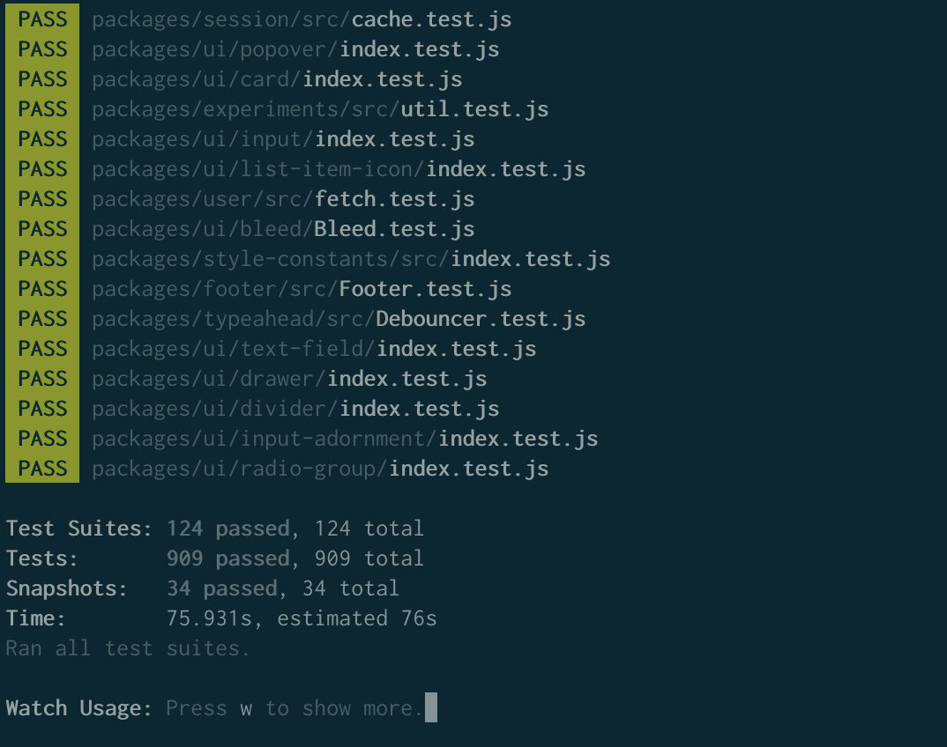
run jest
Basics
npm run test
Notes:
by default jest will run with -o option looking for changes
If any changes are made the tests associated with those changes will run.
If you enter w and press enter you'll see a list of options

Slide 17
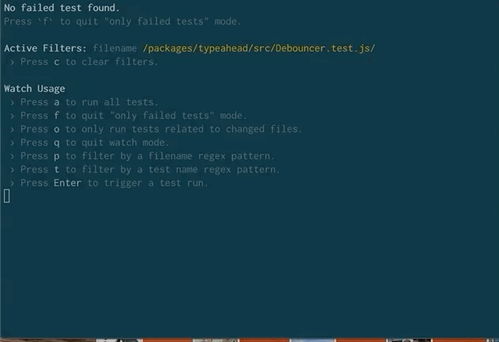

Select ‘p’ to Narrow Selection
Basics
Notes:
The options are easy to understand I use a – run all the tests and -p run a specific test
After you type in the text you can arrow up and down to choose the test(s) that you want to run

Slide 18
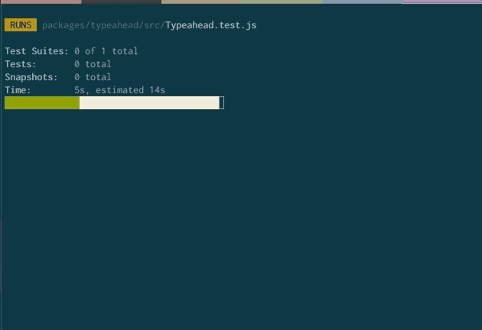
Watch for Changes
Basics
Notes:
As you run jest in watch mode and make changes it will watch for those and run the affected tests. In this way you can more easily stay on top of breaking tests before you check in code changes.

Slide 19
Follow Test Pattern
Basics
Setup
Exercise SUT
Teardown
Verify Results
Notes:
Jest unit tests follow a 4 Phase Test pattern.
Setup – create your fixture, spys and mocks,
Create test data
BeforeAll and afterAll and Describe sections BeforeEach and limited setup within each test
Exercise SUT- call methods off your SUT, can also dispatch events or drive test through DOM
Verify Results - validate and assert the results
Teardown – AfterEach methods help tear down, reset state, restore spys, mocks and stubs.
Jest makes this really easy with a global teardown that you can have run after each test.

Slide 20
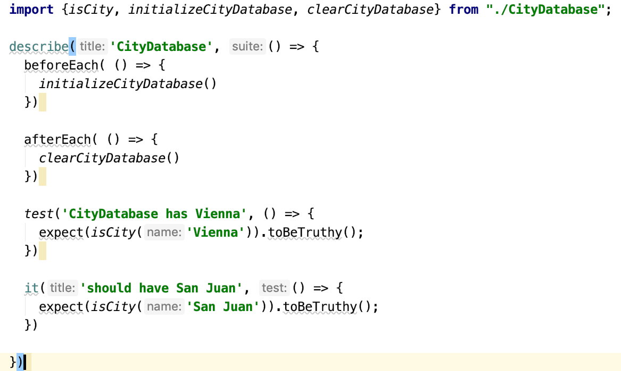
Create Test With Setup/Teardown
Basics
Optional Setup
& Teardown
Built in
Assertions
describe, test or it
https://jestjs.io/
Notes:
Here is an example jest test. We initialize and teardown the database in the beforeEach and afterEach methods
We then run tests which can either be test or it functions.
We try to make the test names descriptive.
Assertions are built into Jest as well as describe, test or it methods.

Slide 21
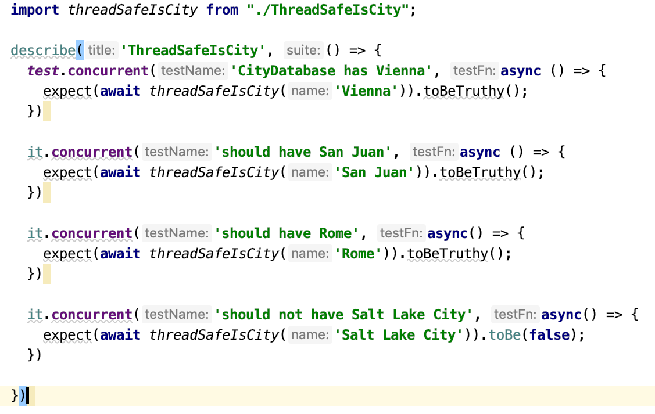
Run Tests Concurrently
Basics
No Setup Teardown
Between Tests
Notes:
Test concurrency is really something you don’t need to worry about, but it’s cool that it works.
In the unlikely event that your tests are running too slow for you to cope with and you know your code is thread safe. You can use the concurrent test method.
Notice that this method requires you return a promise. Also notice that you shouldn’t rely on any setup or teardown between tests. Since running concurrently would break this.

Slide 22
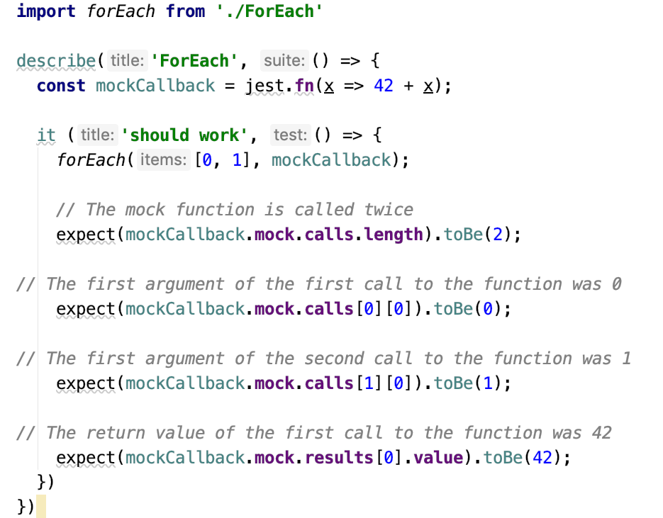
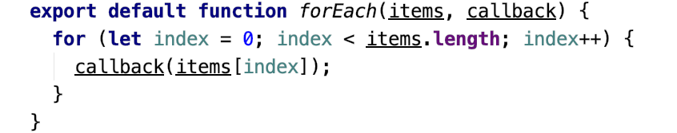
Mock Functions With jest.fn()
Basics
https://jestjs.io/
Notes:
In this example we are wanting to test the that the forEach method properly calls back our callback for each item.
We mock the callback function
Mocking essentially replaces the function and records calls made to it, params, etc.
The mock attribute can be examined after exercising the system under test.
By Asserting the results of the mock you can validate that the function was called with the appropriate values the correct number of times etc.
This can give you confidence that your code it operating as you intended it to.
The jest documentation does a great job documenting the use of mocks.

Slide 23
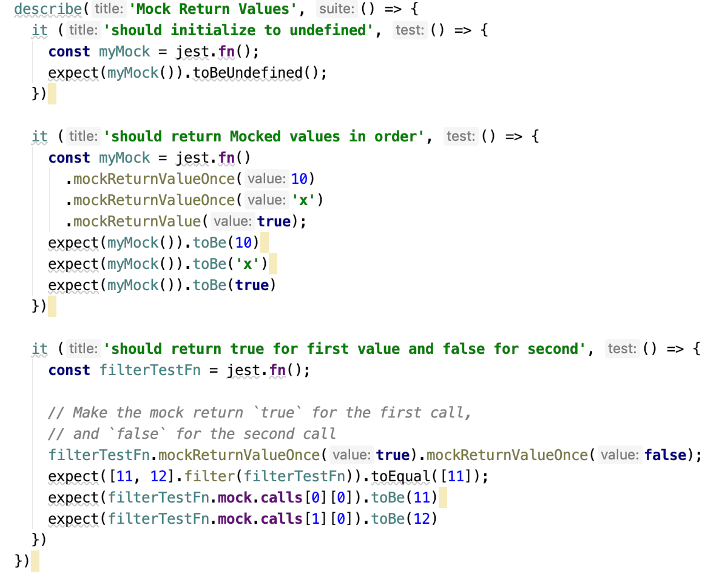
Mock Return Values In Order
Basics
Initialize to
undefined
Mock in ordered chain
True then False
Notes:
You can Mock Return Values in Order of execution.

Slide 24
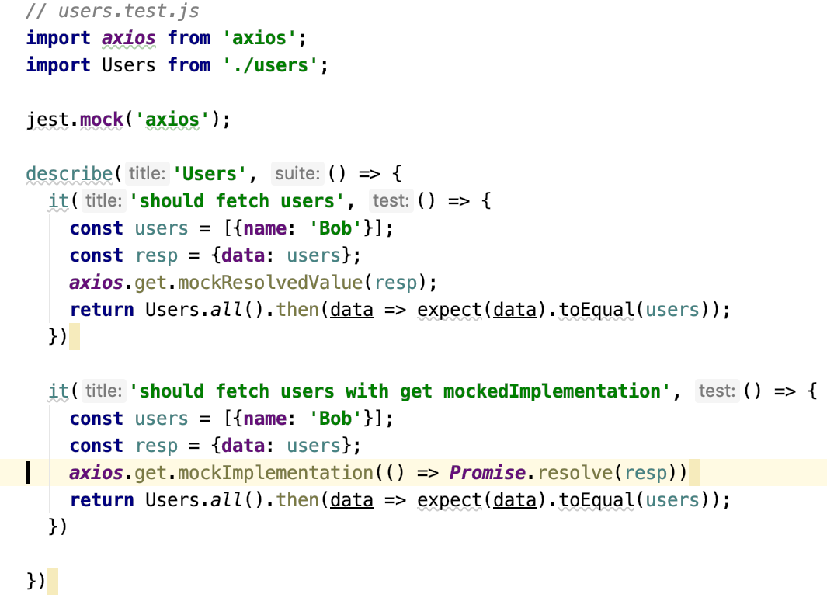
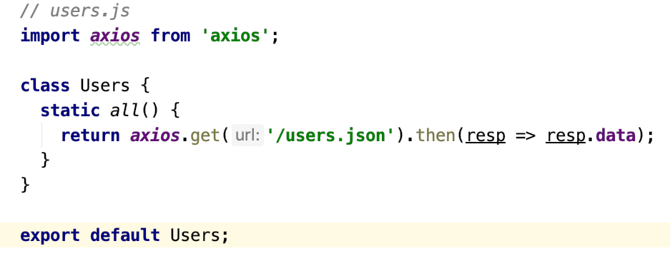
Mock Modules
Basics
Notes:
You can also easily mock a module just by including it.
You then can optionally call mockResolvedValue in sequence that you wish to return the mocked values or
You can also mock the implementation and provide a mocked function that returns the Promised value.
If you do both the mockResolvedValue calls override the default until they are exhausted and then it reverts to the mocked function.

Slide 25
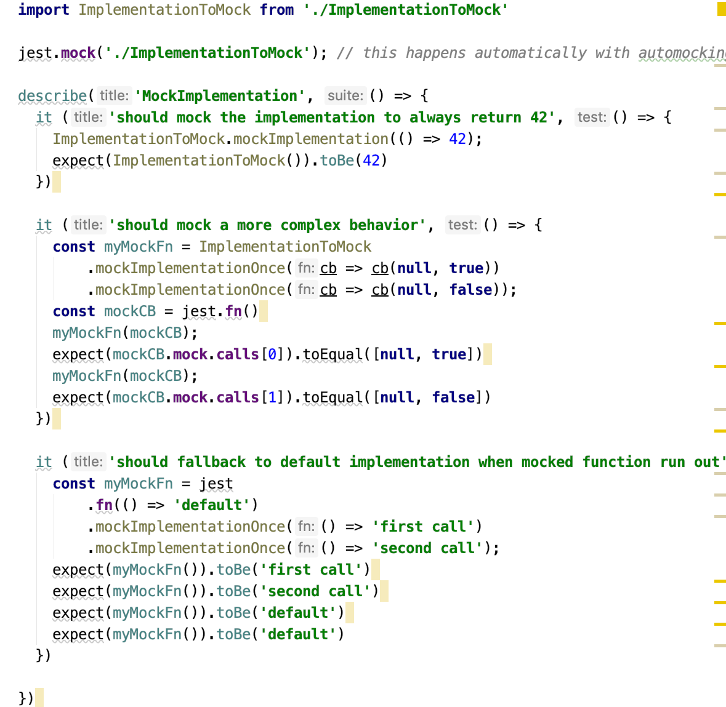
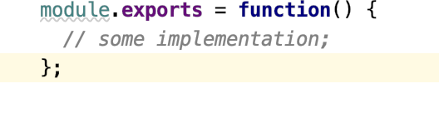
Mock Implementations
Basics
Notes:
Sometimes a test requires going beyond returning a sequence of values. Instead you need to return something based on input or something else. In these cases you may need to mock the implementation.
Perhaps you need to define the default implementation of a mock function that is created from another module.
When you need to recreate a complex behavior of a mock function such that multiple function calls produce different results, use the mockImplementation* methods.
When the mocked function runs out of implementations defined with mockImplementationOnce, it will execute the default implementation set with jest.fn (if it is defined):

Slide 26
Use React Testing Library (RTL)
Basics
Light Weight
Dom Testing Library
Promotes Good Tests
User Based
Good APIs
Light weight
Enhances JEST
Simple
Understandable
Multiple Frameworks
Accessible
Maintainable
https://testing-library.com/docs/dom-testing-library/intro
Notes:
Kent Dodd – “The more your tests resemble the way your software is used, the more confidence they can give you.”
Tests run in JSDOM that models a browser environment. JSDOM is good enough for integration and unit testing react components and runs much faster than in a real browser.
Tests focus on loading actual components into Dom trees whose output can then then be asserted.
Output elements are targeted the same way a user would target them, (e.g. by User Assessible features such as visible text and label, or aria labels that a screen reader would use.)

Slide 27
Install React Testing Library
Basics
npm install --save-dev @testing-library/jest-dom
Dom Queries
Custom Matchers
toBeDisabled, toBeEnabled, toBeEmpty, …
npm install --save-dev @testing-library/react
render, cleanup, etc.
Notes:
Jest-dom
Query methods
Provide simple functions for checking for an element's attributes, its text content, its css classes, etc.
React Testing Library

Slide 28
Use Dom Testing Library (DTL) Queries
Basics
Variants
getBy, getAllBy, queryBy, queryAllBy, findBy
Queries
LabelText, PlaceHolderText, Text, AltText, Title, DisplayValue, Role, TestId
Text Match – string, regex, or function, optional precision & normalization
Notes:
RTl builds on the Dom Testing Library. Which is all about Querying the Dom.
There are three basic section you should understand. Queries are prefixed by Variants. GetBy, getAllBy, queryBy, queryAllBy, findBy
The difference between Get and Query are Get will throw exceptions when targets are not found. If your looking for the absence of a component you’ll need to use query variants they will just return null.
Find variants return a promise that will resolve or reject within the timeout period.
The second thing is the knowing what you can query. Queries are all about what is accessible to the user. What can he view. How will a user identify and find a field. By text, label, aria-lable, alt-text, title, displayValue, role, testId, ect.
The third thing that is important to learn is the TextMatch parameters that can be passed into the Queries. It can be a string, regex, or function. There are also optional precision and normalization parameters that can alter the textMatch in the query.

Slide 29
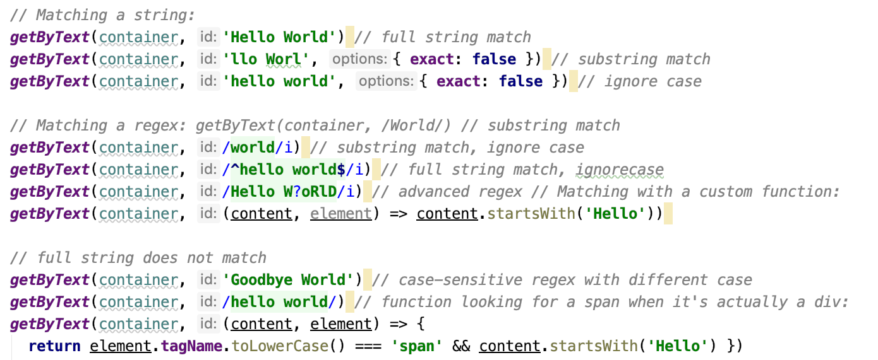
Use DTL TextMatch Examples
Basics
Given Container
<div>Hello World</div>
Notes:
If your container contains a div with "Hello World" text you could use one of these d TextMatch examples.

Slide 30
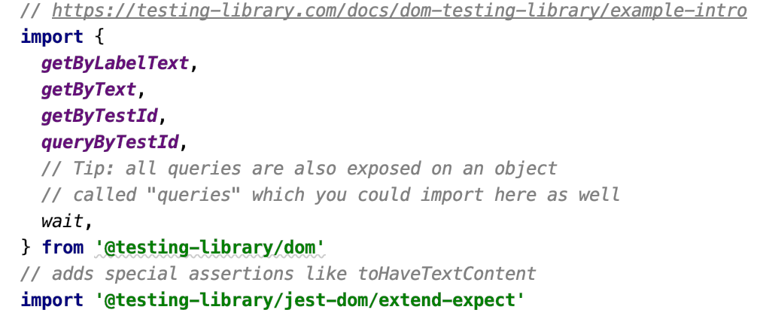
Import Queries From DTL
Basics
Notes:
First we import the query methods we will use in our test.

Slide 31
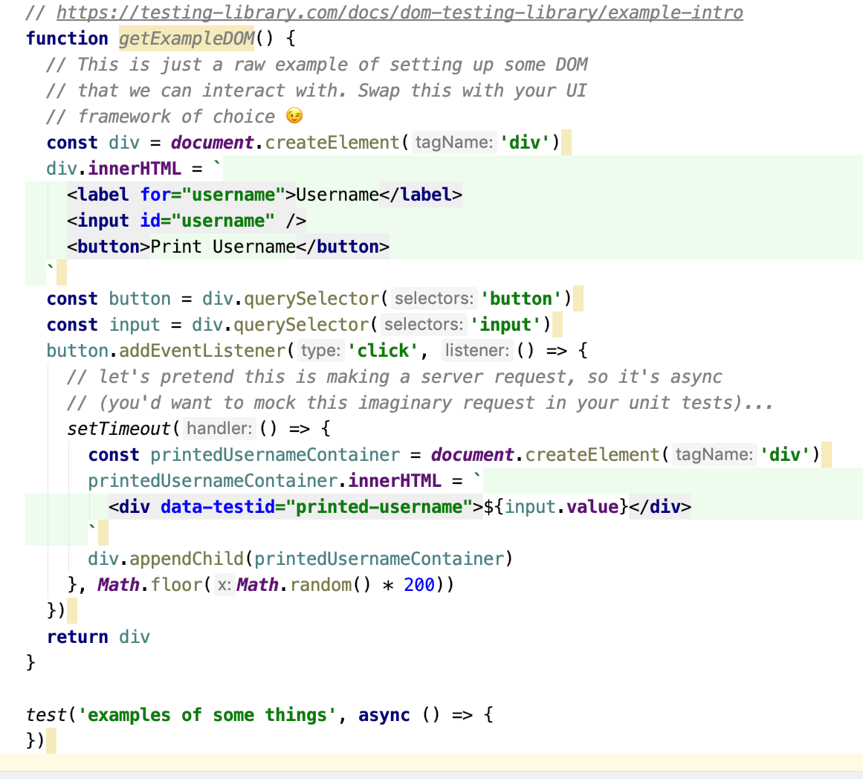
Generate DOM Tree
Basics
Notes:
Let next look at the method we are creating our DOM tree from.

Slide 32
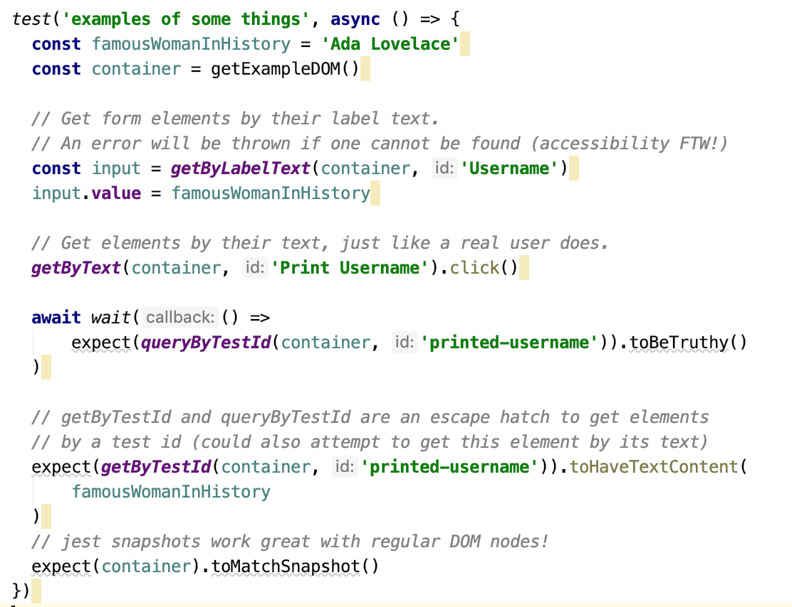
Generate and Assert DOM Output
Basics
DTL Allows you to Generate
Dom How Ever You Like
Notes:
Now that we have the imports and the Dom tree methods in place lets look at the actual test.

Slide 33
Use Other RTL Methods
Basics
render (render your component)
fireEvent
trigger Dom events
Use helper methods (e.g. fireEvent.click, fireEvent.change, etc.)
Other Methods
Within take a DOM node and return and wrap it with all the queries
(.e.g within(node).getByText("hello"))
Cleanup – clear all the DOM
Notes:
The RTL pattern is slightly adjusted in that you focus on Rendering a Dom tree and then target and assert on it's output.

Slide 34
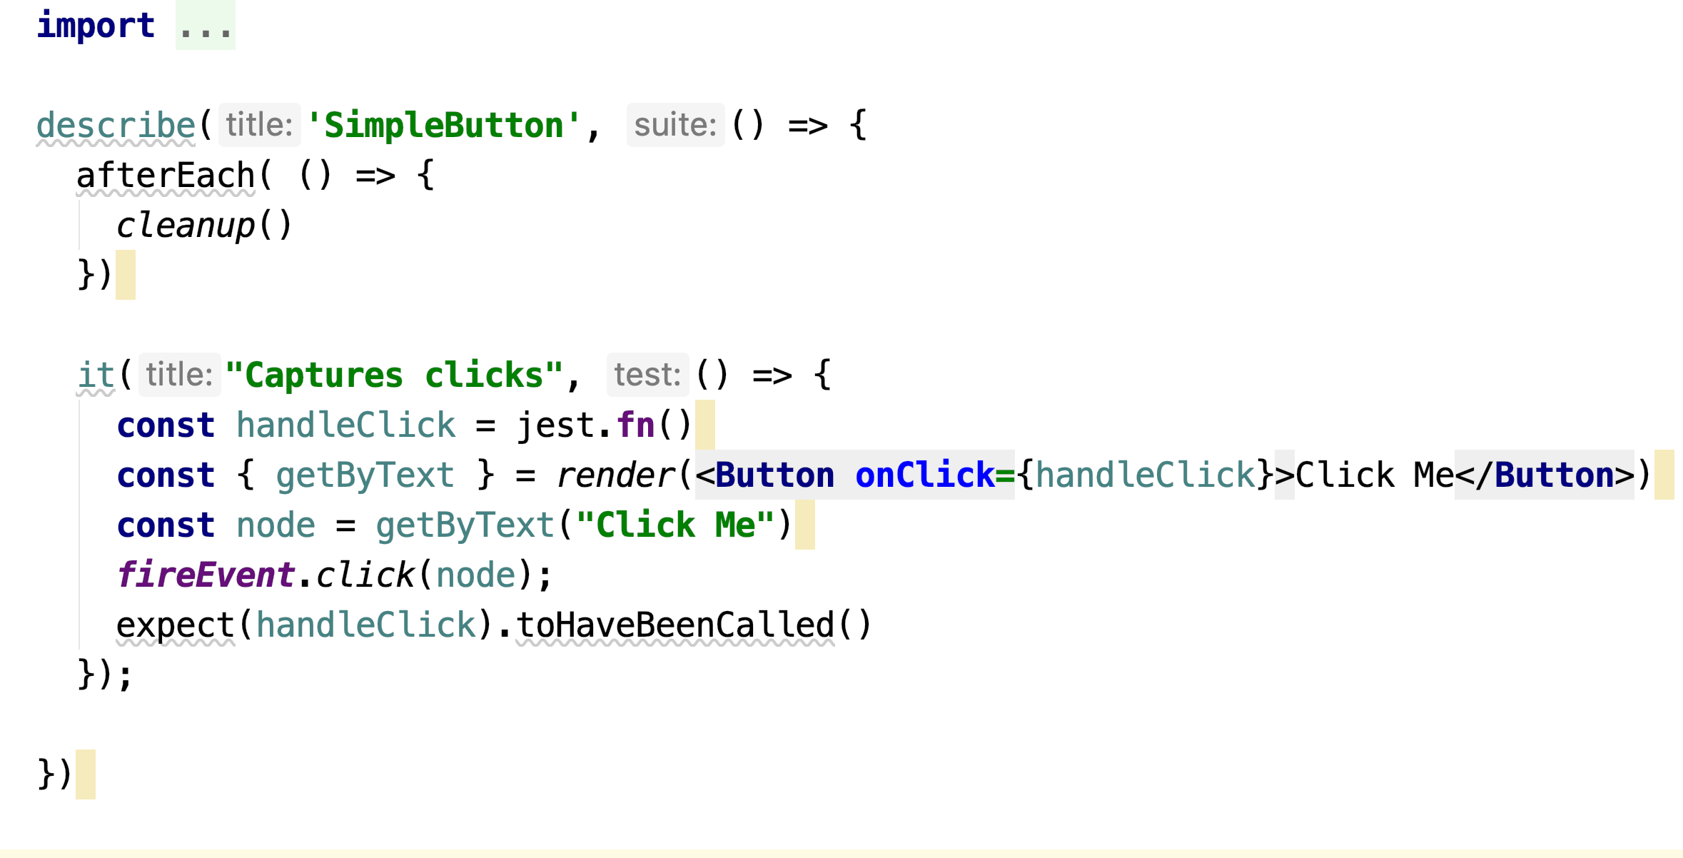
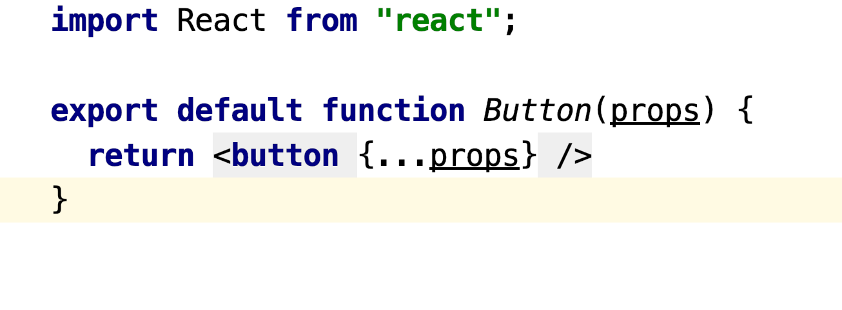
SimpleButton RTL test
Basics

Slide 35
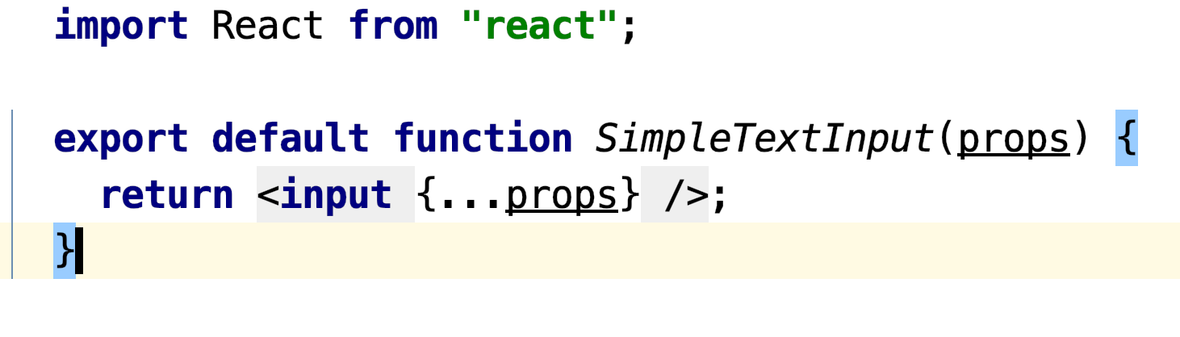
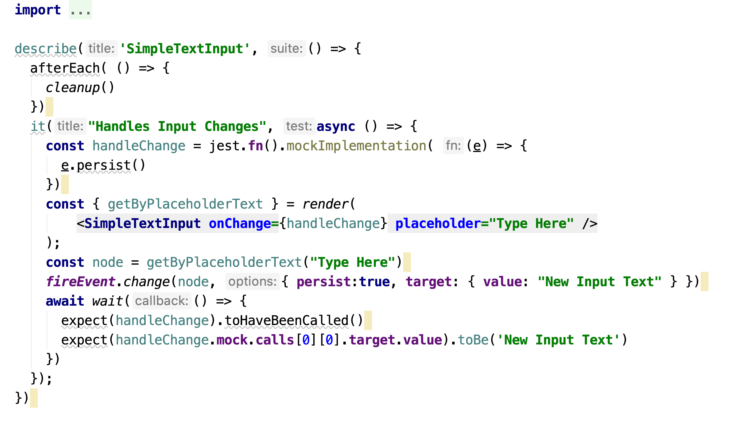
SimpleTextInput RTL *test.*
Basics

Slide 36
Use Design Patterns to Overcome Common Testing Challenges
Design Patterns
Testing Asynchronous Events (API, Changing DOM, Events)
Mocking dependencies of dependencies
Targeting and Testing Complex DOM
Maintaining Too Many Tests

Slide 37
Use Async Functions
Design Patterns
wait (Promise) retry the function within until it stops throwing or times out wait
waitForElement (Promise) retry the function until it returns an element or an array of elements
waitForDomChange (Promise) retry the function each time the DOM is changed
waitForElementToBeRemoved (Promise) retry the function until it no longer returns a DOM node

Slide 38
Mock Dependencies of Dependencies
Design Patterns
Don’t Mock Unless you have to.
Mock entire module or submodule
__mocks__
Mock file paths
automatic hoisting
easy to override
Notes:
Mocking severs the real-world connection between what you're testing and what you're mocking. Kent Dodds
Poke fewer holes in reality, less mocking, less shallow rendering, test higher up your tree – Kent Dodds

Slide 39
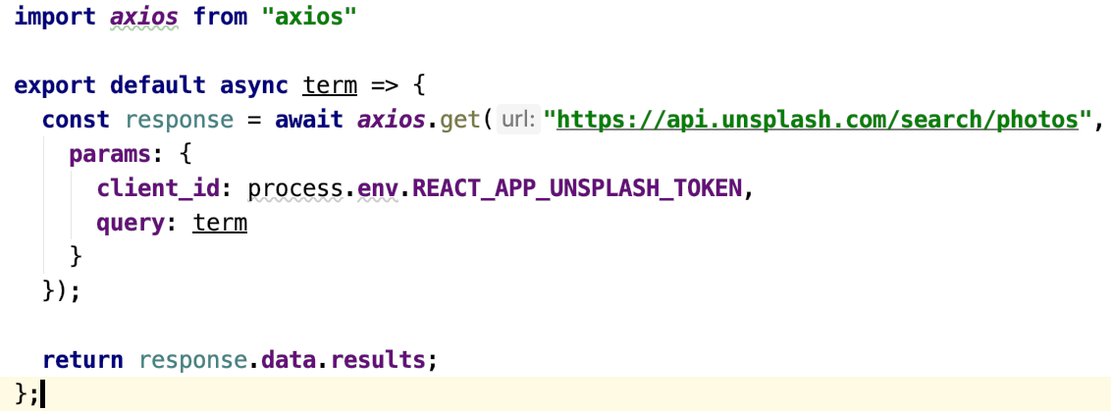
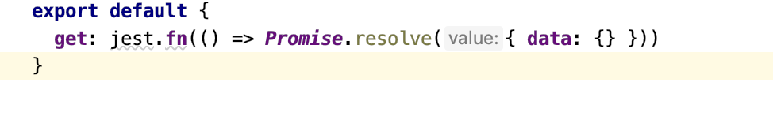
Mock Async API Functions
Design Patterns
…/src/UnsplashService
…/src/__mocks__/axios.js
https://www.leighhalliday.com/mocking-axios-in-jest-testing-async-functions

Slide 40
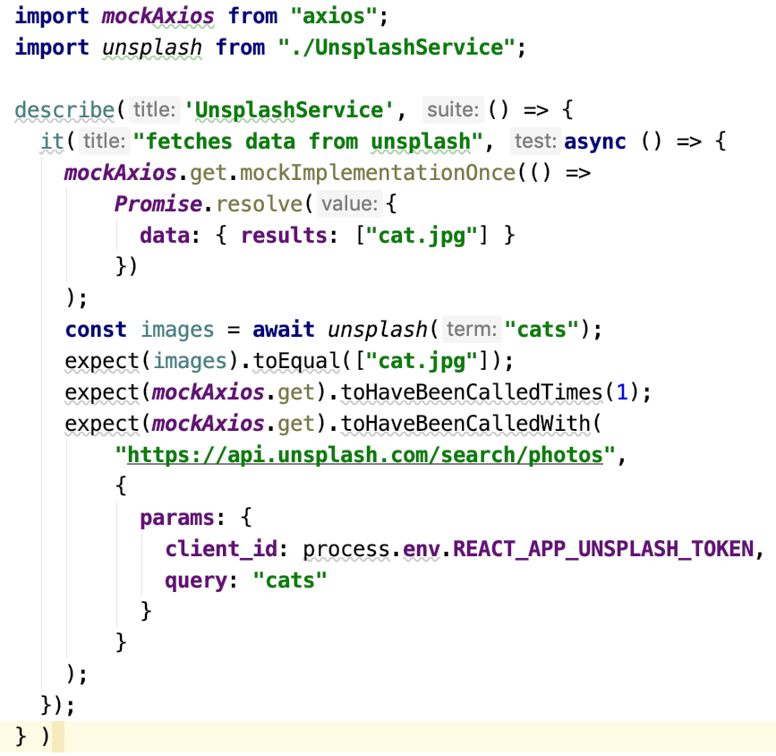
Mock Async Functions
Design Patterns
auto-mocked
Mock Once For Testing
Validate Results
https://www.leighhalliday.com/mocking-axios-in-jest-testing-async-functions

Slide 41
Verify Complex DOM With Snapshots
Design Patterns
Snapshots are easy to use for styles and DOM trees
Prefer in-line snapshots
Keep snapshots as small as possible for performance

Slide 42

Avoid JS-DOM Fallbacks
Design Patterns
Use debug() in your test to determine what’s in your DOM tree
Start with RTL query methods
(https://testing-library.com/docs/react-testing-library/cheatsheet)
Fallback to testId only when necessary
No querySelector ( This is sure to be code debt that you will need to clean up!)

Slide 43
Too Many Tests To Maintain
Design Patterns
Write resilient tests of higher quality
Only use RTL methods
Keep Cyclo-complexity to 1)
Do not test implementation details
Remove weak tests or tests that duplicate other tests
Consider Model Based Testing (MBT)

Slide 44
Consider Model Base Testing
Design Patterns
Base the Model off the system your testing not the tests that you want
Keep model as simple as possible. (You probably don’t need to test every possible combination)
Let the generator use your decision tables to generate the actual tests

Slide 45
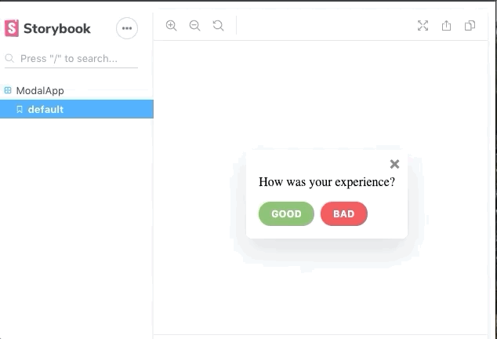
Write MBT for Model For Feedback
Design Patterns
Write Fewer Tests! From Automation to AutoGeneration – David Khourshid
React Rally 2019
Notes:
occur
https://css-tricks.com/model-based-testing-in-react-with-state-machines/

Slide 46
Create a Test Model
Design Patterns
States
question, form, thanks, closes
Initial state – question
Final state - closed
Events
CLICK_GOOD, CLICK_BAD, CLOSE, SUBMIT
Transitions
Defines the new state after an event occurs from a particular state.
(e.g. When in question state and CLICK_GOOD event occurs, the user will end up in the thanks state).
Write Fewer Tests! From Automation to AutoGeneration – David Khourshid
React Rally 2019
Notes:
occur
https://css-tricks.com/model-based-testing-in-react-with-state-machines/

Slide 47
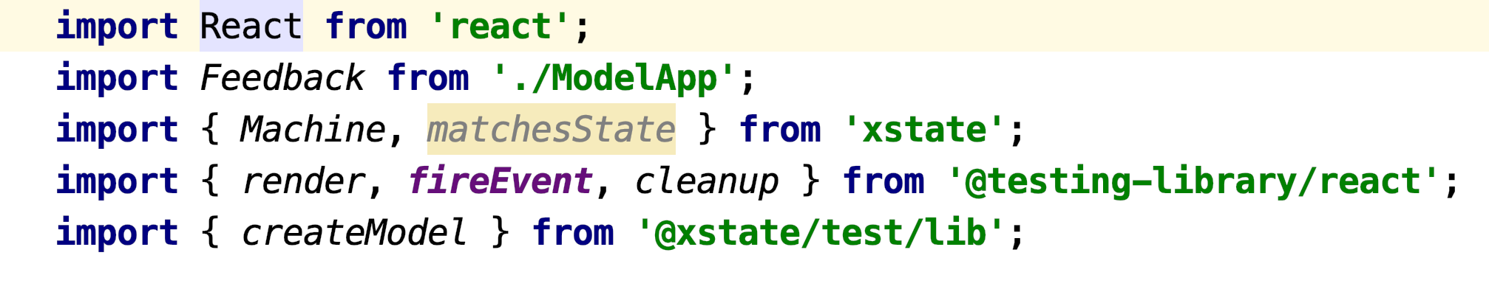
Import Dependencies for MBT
Design Patterns
Write Fewer Tests! From Automation to AutoGeneration – David Khourshid
React Rally 2019
Notes:
https://css-tricks.com/model-based-testing-in-react-with-state-machines/

Slide 48
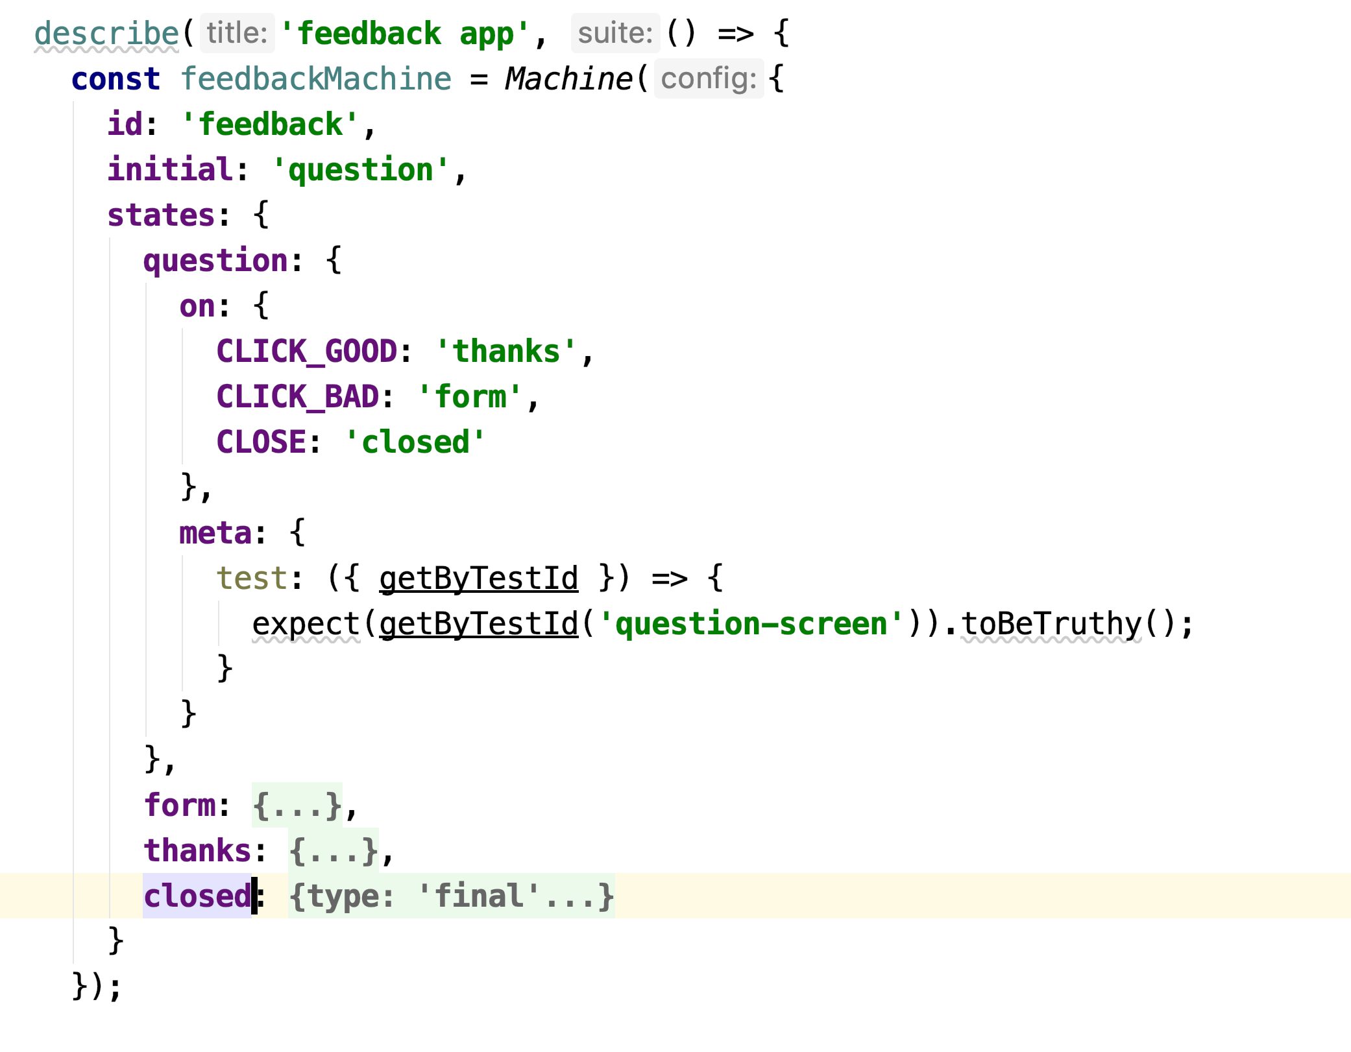
Create Machine States
Design Patterns
Write Fewer Tests! From Automation to AutoGeneration – David Khourshid
React Rally 2019
Notes:
https://css-tricks.com/model-based-testing-in-react-with-state-machines/

Slide 49
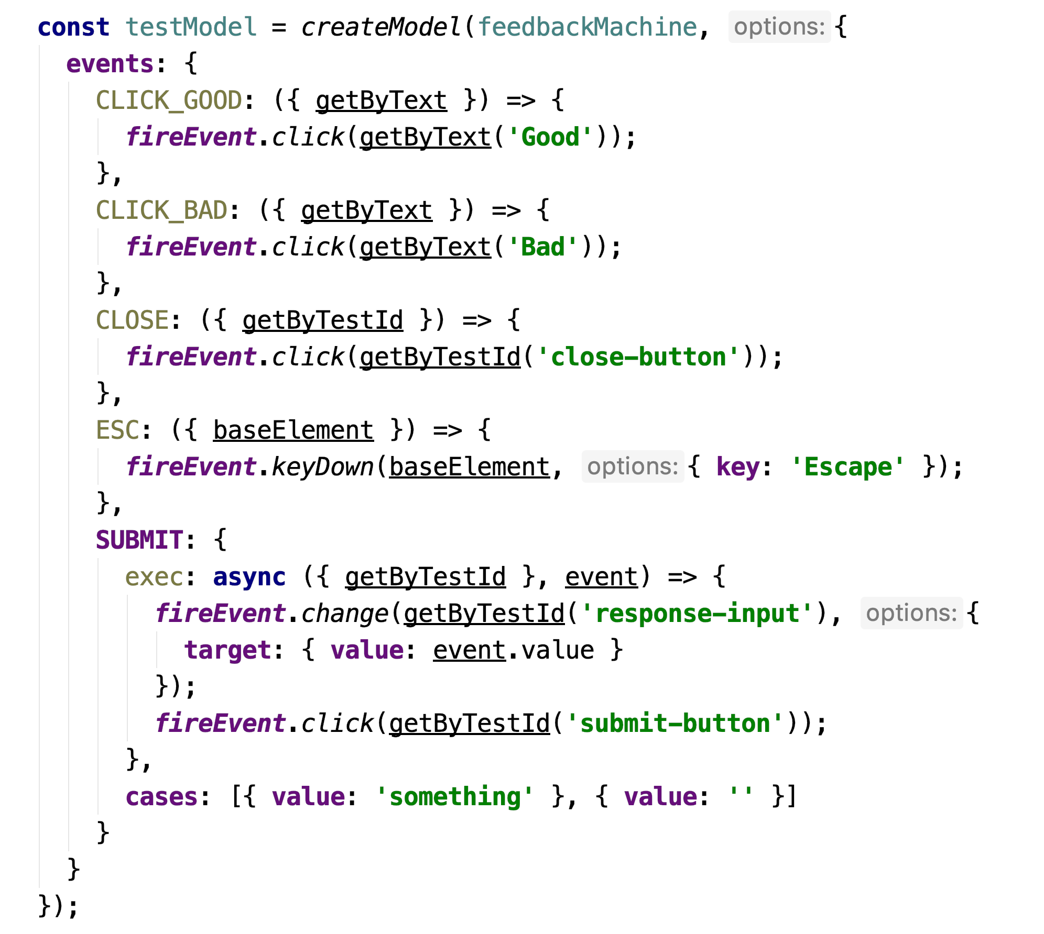
Create Model
Design Patterns
Write Fewer Tests! From Automation to AutoGeneration – David Khourshid React Rally 2019
Notes:
https://css-tricks.com/model-based-testing-in-react-with-state-machines/

Slide 50
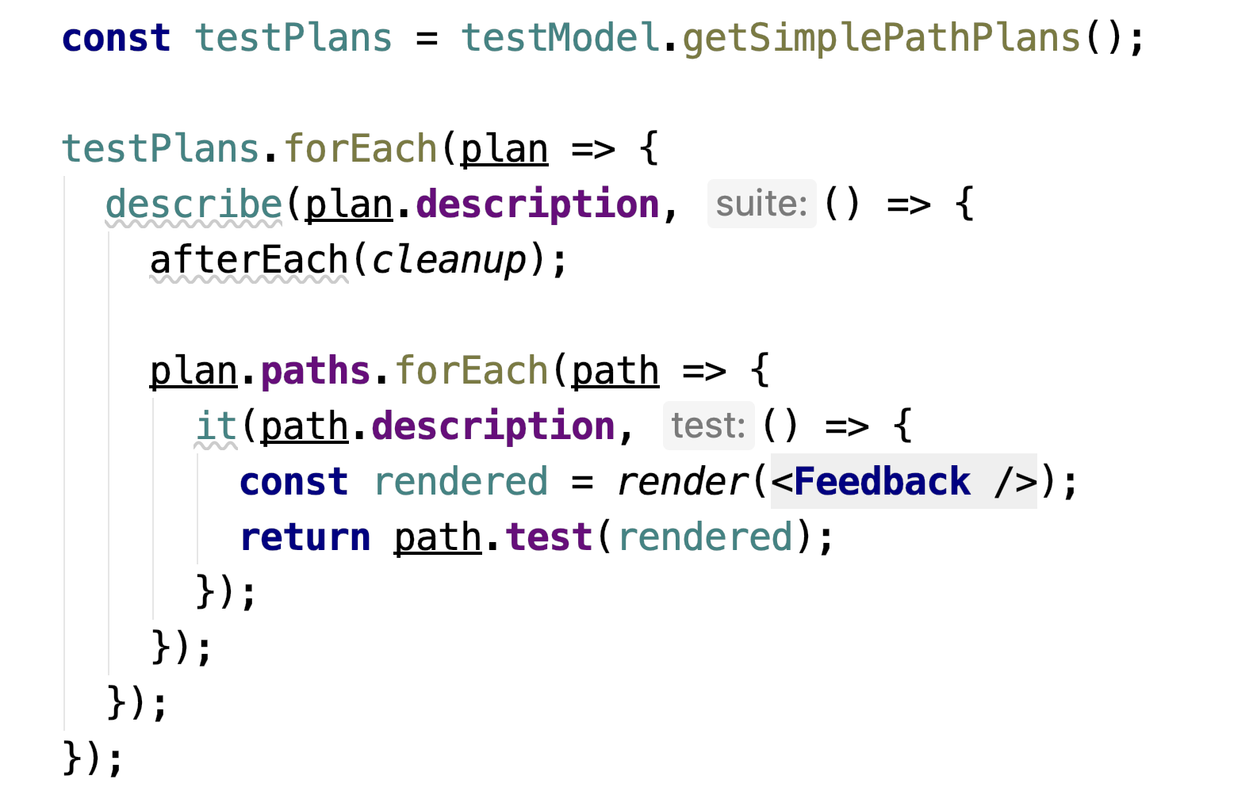
Generate Tests From Model
Design Patterns
Write Fewer Tests! From Automation to AutoGeneration – David Khourshid React Rally 2019
Notes:
https://css-tricks.com/model-based-testing-in-react-with-state-machines/

Slide 51
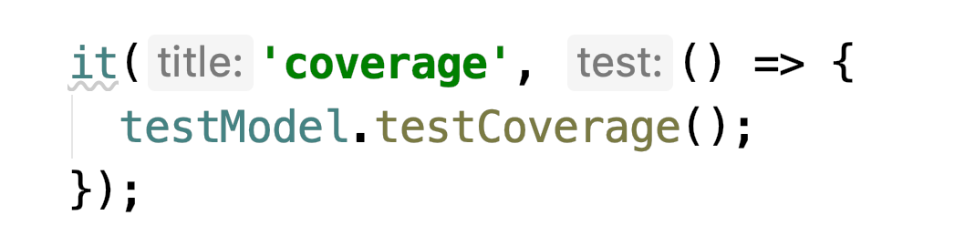
Ensure Coverage is Met
Design Patterns
Write Fewer Tests! From Automation to AutoGeneration – David Khourshid React Rally 2019
Notes:
https://css-tricks.com/model-based-testing-in-react-with-state-machines/

Slide 52

Don’t Write Any More Tests !

Slide 53
Integrate into CI pipeline
Process Integration
Require tests to pass in Travis-CI before PRs are merged
Run tests before production deploy (e.g. Electric Flow)
Notes:
For web components tests (like fs-webdev/fs-add-person): wct --skip-plugin sauce --local chrome

Slide 54
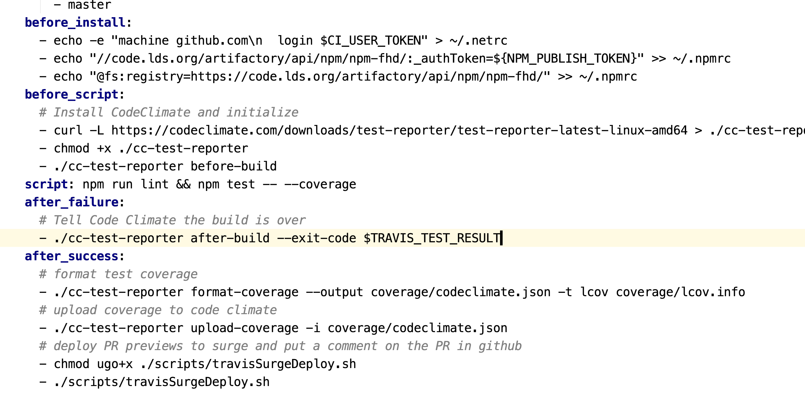
Travis CI
Process Integration
Notes:
For web components tests (like fs-webdev/fs-add-person): wct --skip-plugin sauce --local chrome

Slide 55
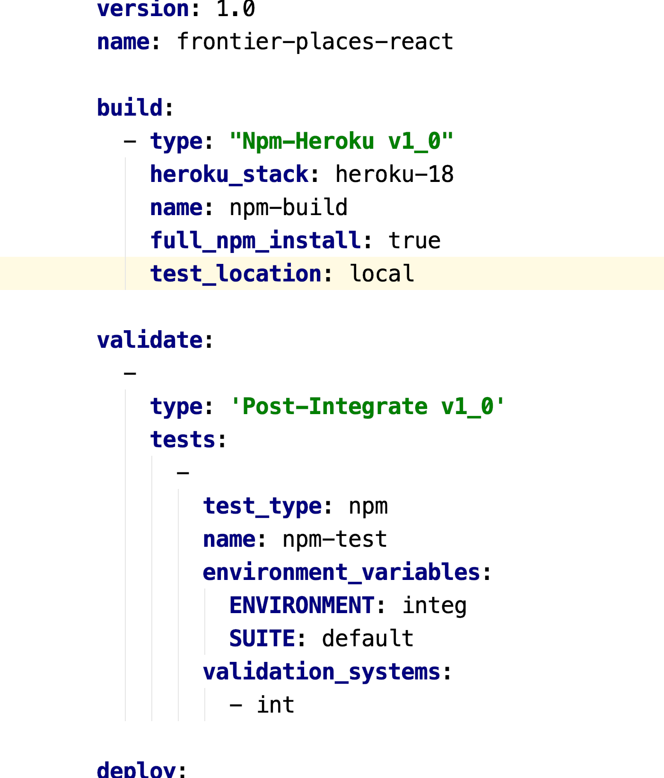
Integrate into CI pipeline
Process Integration
Notes:
For web components tests (like fs-webdev/fs-add-person): wct --skip-plugin sauce --local chrome

Slide 56

Remember the Ibex

Slide 57

Take your Testing to the Next Level

